Slide 1


Future-Proof Fleet
Data Insights for a Safer, Smarter Transportation
Group 1:
Hao-Yu Chou, Shalini Dixit, Shriya Dubey, Jishita Durgempudi,
Jack Feen, Sri Gabbita

Slide 2
Introduction
Problem Statement
Risk Assessment Methodology
Data Analysis Insights
Final Decisions
Agenda

Slide 3
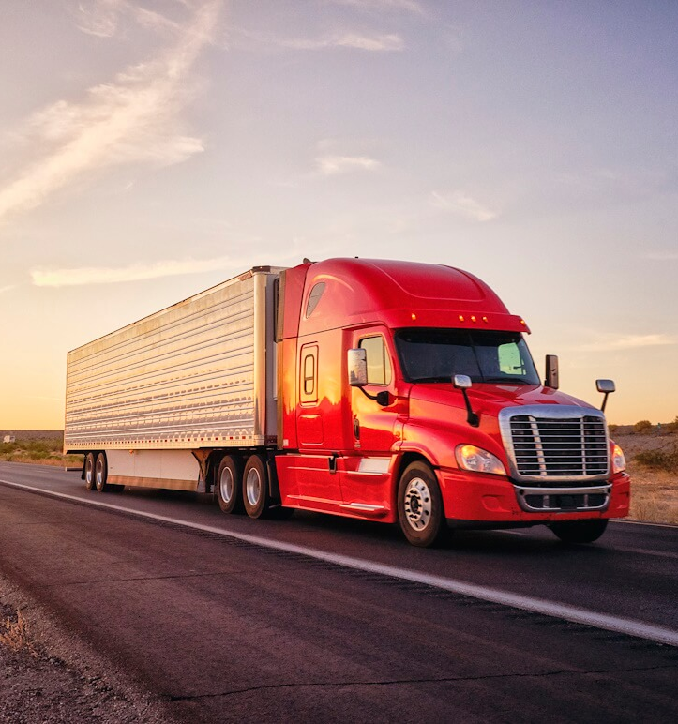
Introduction
Az National Trucking
Long-distance trucking services for cargo in the western U.S.
Employees: 400 total
Staff: 40
Drivers: 310
Fleet Manager
Ensure drivers follow company rules and regulations.
Mitigate risks related to speeding, unsafe following, lane departure, etc.
Monitor driver behavior to reduce accidents.

Slide 4
Key Problems
How can we enhance fleet safety?
What is the optimal truck model?
In-depth identification of risky drivers.
Modifications to our existing truck fleet.
Analysis of metrics such as risk factor and operational costs.

Slide 5





Data Processing
1. Local
File Collection
2. Data Transformation
3. Upload to HDFS
4. Data Processing
5. Data Analysis

Slide 6
How can we enhance fleet safety?

Slide 7
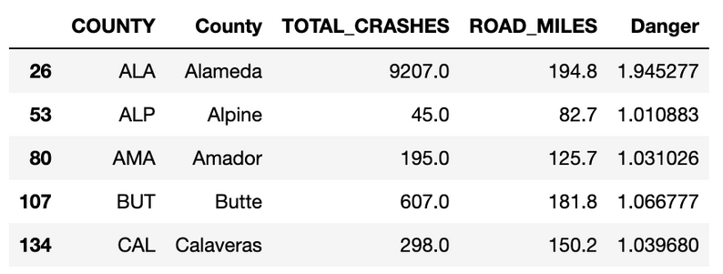
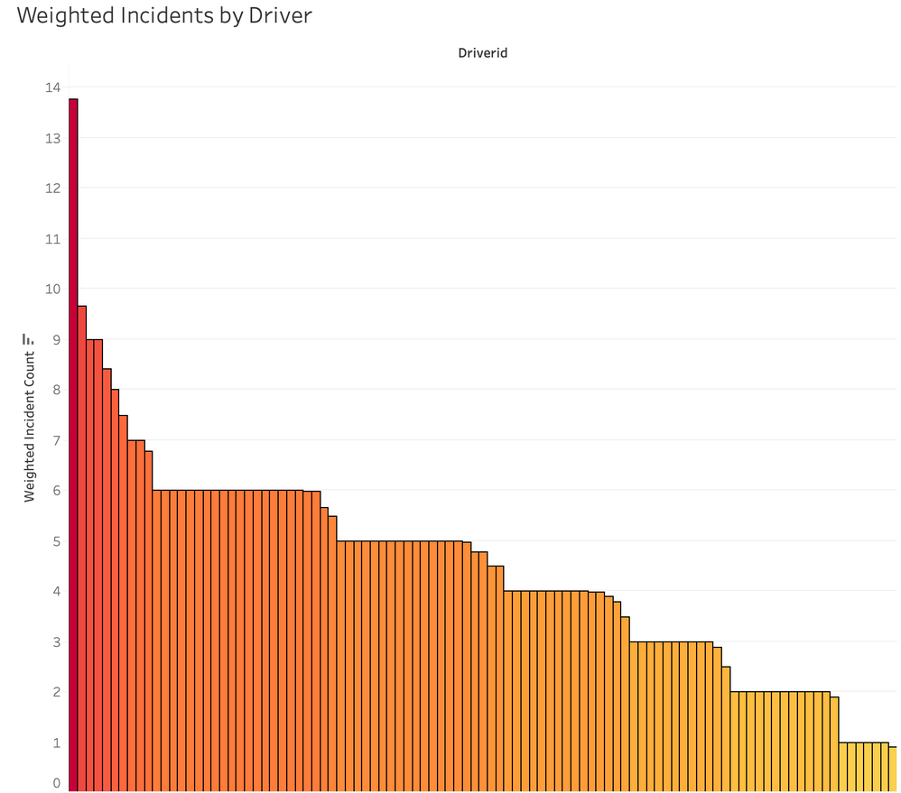
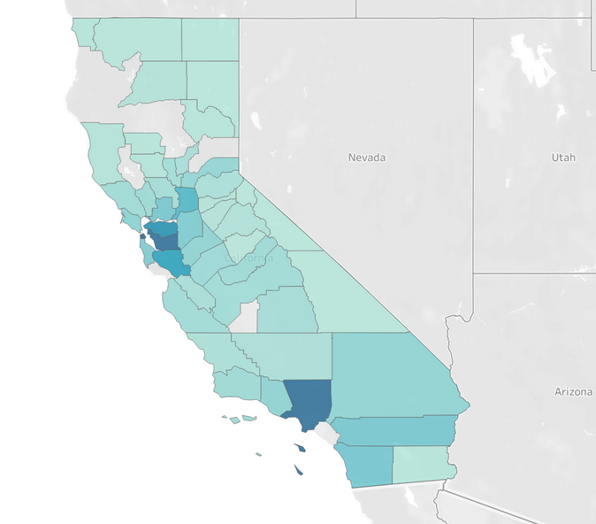
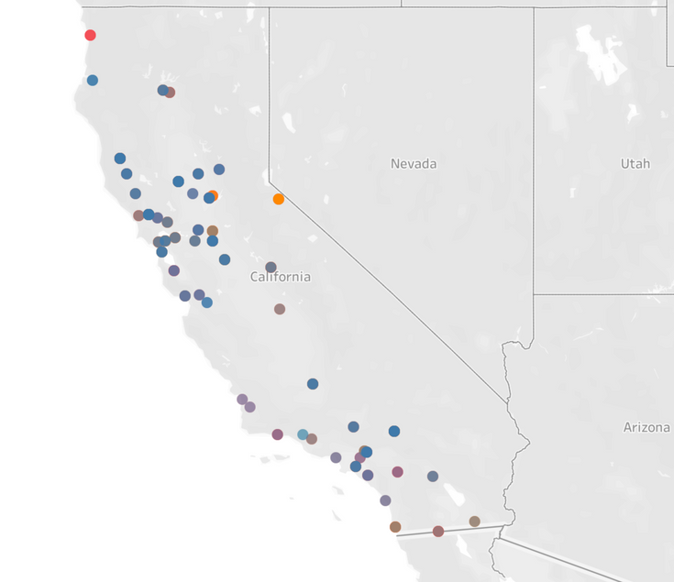
Identification of Risky Drivers
Incidents Per Driver
Weighted by location of incident
Classification of Road Saftey
Enhancing fleet safety

Slide 8

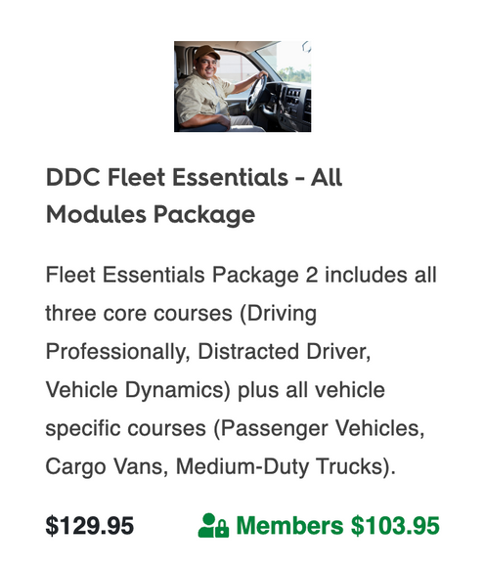
Reccomendation
Preventative
Reactive
Introduce employees to the strong safety standards upheld by ANT
Require addition defensive driving education for risky drivers
(>6 weighted risk factor )
Enhancing fleet safety

Slide 9
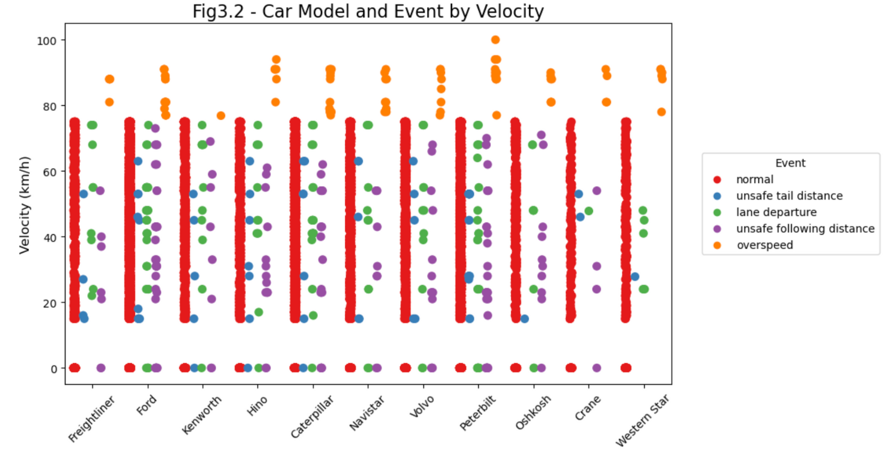
Event Distribution
Takeaways
Overspeed only registered above 75 mph
Roughly even distribution of unsafe events
Enhancing fleet safety

Slide 10
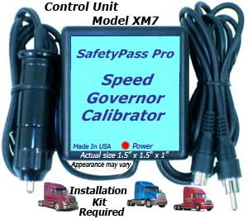
Recommendation
Speed Governors
Limit vehicle speed to 75 mph
Price
$120/Speed Governor * 300 Trucks =
$36,000 Total
Enhancing fleet safety

Slide 11
What is the optimal truck model?

Slide 12
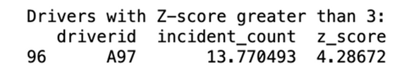
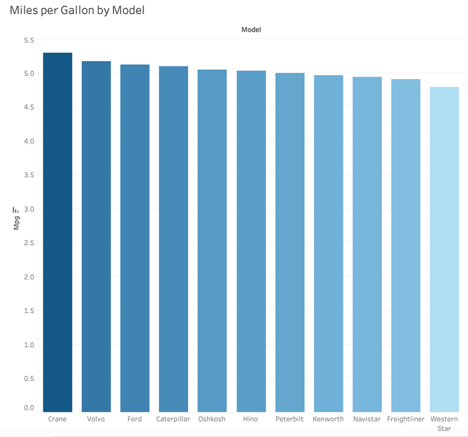
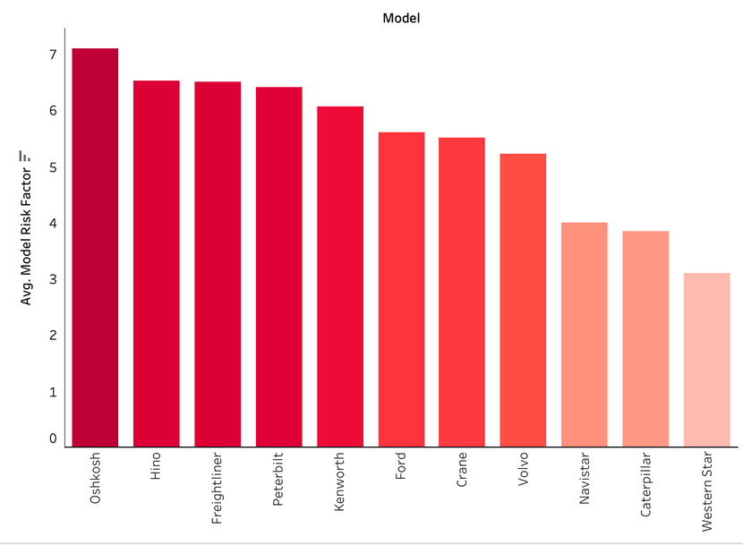
Rating
Factors Considered
Enriched with outside geolocational data
Outlier drivers removed
Overspeed not considered
Risk Scores
Best:
Western Star - 3.09
Caterpillar - 3.84
Navistar - 3.99
MPG Rankings
Best:
Crane - 5.29
Volvo - 5.17
Ford - 5.13

Slide 13
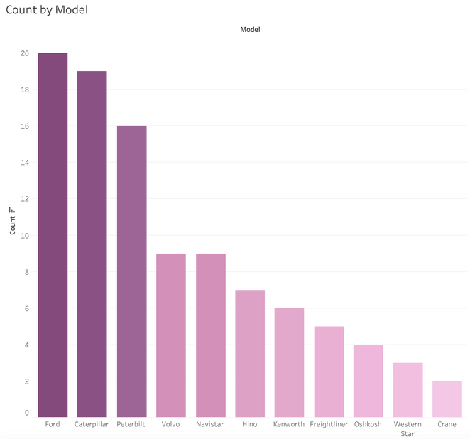
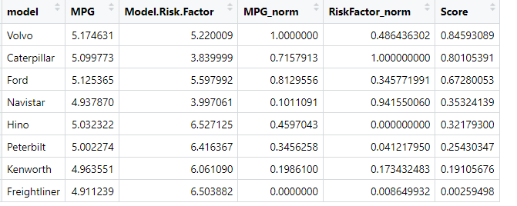
Scoring
MPG normalizing and Risk factor normalizing
MPG*0.7+Risk factor*0.3
Best:
Volvo - 0.8459
Kenworth - 0.80105
Ford - 0.6728
Worst:
Freightliner- 0.00259498

Slide 14
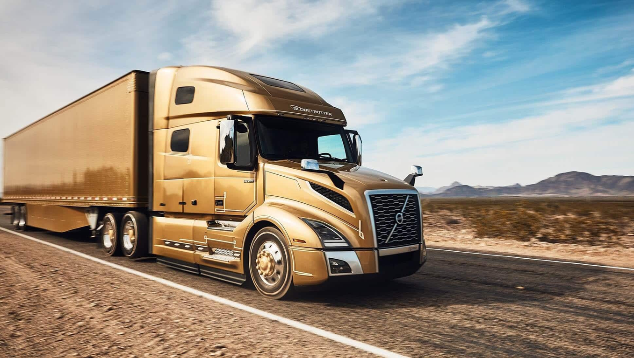
Reccomendation
Volvo
1nd best MPG - 5.17
Average Risk Tolerance
Overall Score - 84.59/100
Given ANT’s propensity to expand, Volvo trucks are an ideal combination

Slide 15
Final Decisions

Slide 16

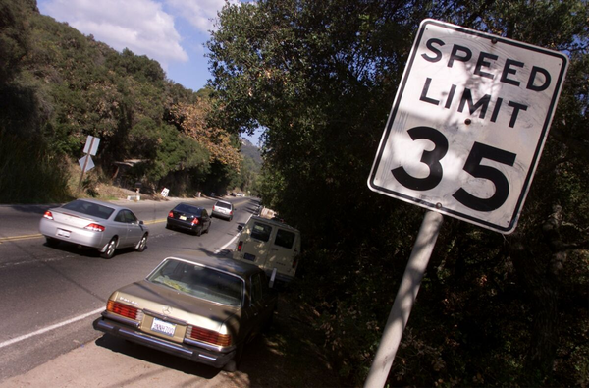
Final Decisions
Safe Driving Programs
Speed Governors
Ideal Truck Selection
Required preventative course of all drivers
Speeding prevention with speed governors
Ideal truck for business expansion - Volvo
Reactive defense drivers course for risky drivers

Slide 17

Thank you!
Any Questions?

Slide 18
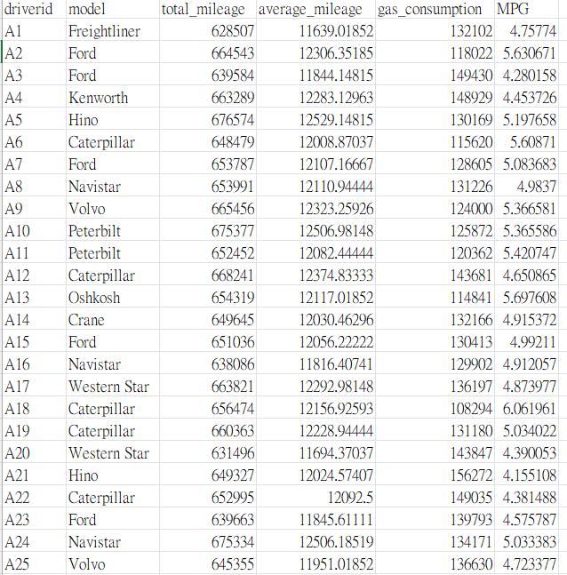
Calculating MPG by person
Extra slides

Slide 19
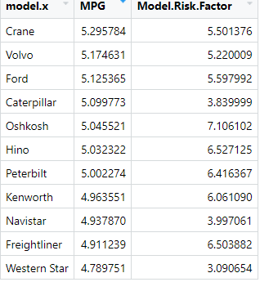
Average MPG base on model and import Risk factor
Extra slides

